Slide 1
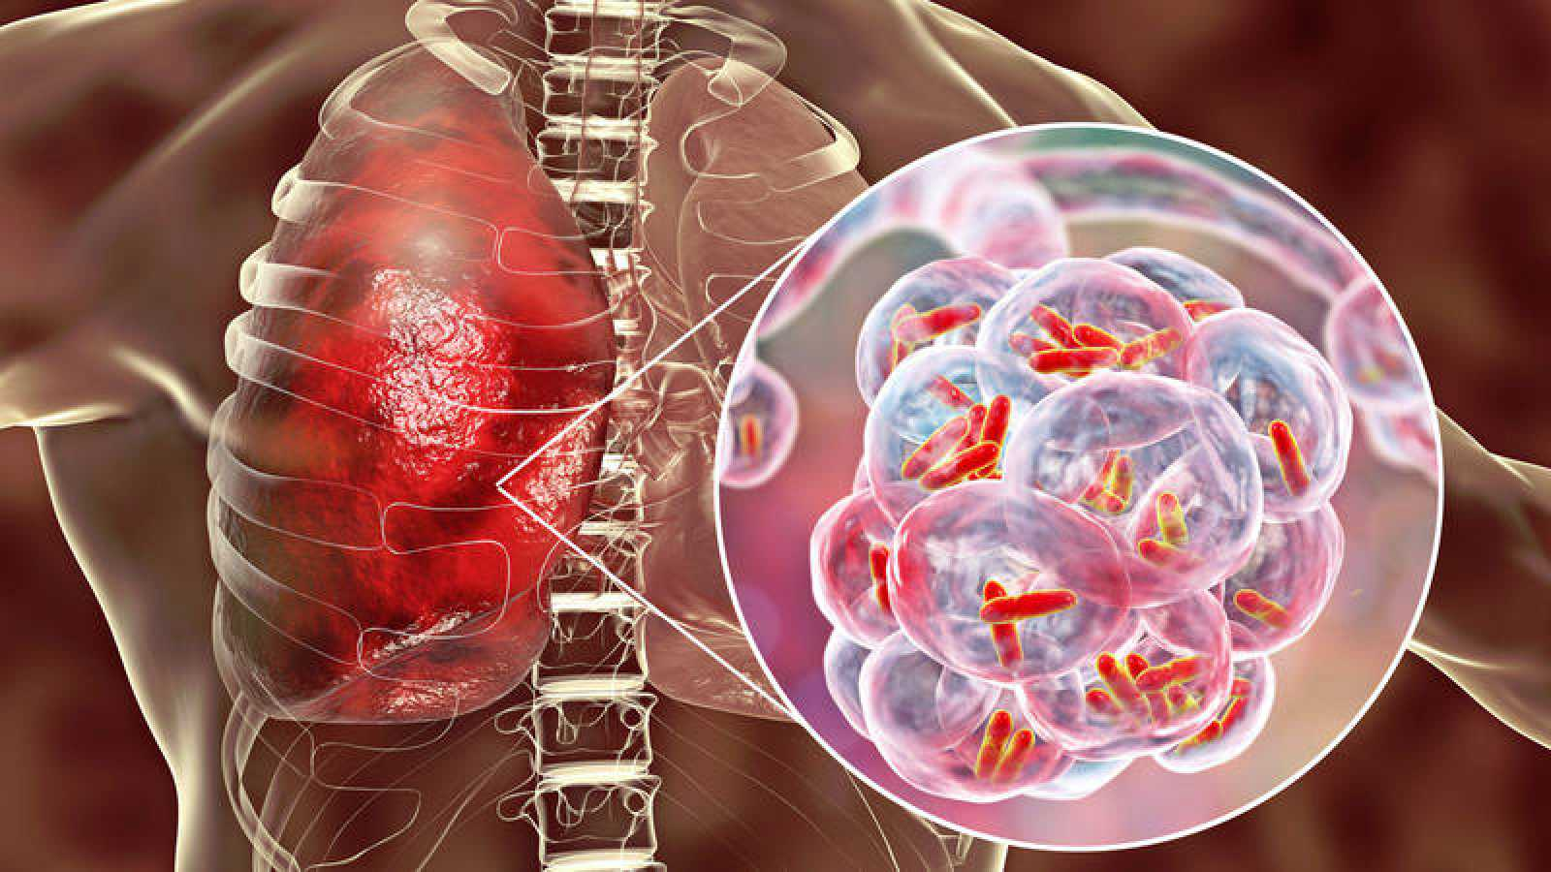
Fighting Against Global Tuberculosis
Medicube Consulting
Yeo Xiu Juan
Cho Wai Hlaing
Nyein Ei Zaw
Riju Jose
Shreeyasen Senthilkumar
Notes:
Shreeya

Slide 2
Background information's
Global Impact: Tuberculosis (TB) remains a major global health challenge, with millions of new cases and deaths annually.
Disproportionate Burden: Low- and middle-income countries consistently report higher TB rates due to limited healthcare access, delayed detection, and inadequate treatment.
TB-HIV Co-epidemic: HIV-positive individuals have a significantly higher risk of developing active TB. The co-epidemic is particularly severe in high HIV-prevalence regions like sub-Saharan Africa.
Mortality Impact: TB remains a leading cause of death among people living with HIV, with co-infection substantially increasing mortality risk.
Integrated Strategies: Combining TB and HIV prevention, screening, and treatment is essential. Expanding access to antiretroviral therapy and improving TB diagnostics are critical for controlling both diseases.
Health System Strengthening: Efforts focus on improving detection, treatment, and integrating healthcare with socioeconomic policies to reduce TB prevalence and address disparities.

Slide 3




Stakeholders in the Fight Against TB
WHO
Global Policies, funding, monitor trend
Ministries of Health
National TB strategies, community engagement
Healthcare Workers
Diagnose & treat patients
TB Patients & Survivors
Advocacy, support, reducing stigma
NGOs & Community Groups
Awareness campaigns, access support
Policymakers
Laws, resource allocation
Funding Agencies
Financial support (Global Fund, World Bank)
Public, Schools, Employers
Education, prevention, community participation
Media & Advocates
Awareness, shape public opinion
Tech & Innovation Firms
Diagnostics, health tracking tools

Slide 4
Problem Statement
Resurgence and Persistence of Tuberculosis (TB)
Complacency in TB Control
Early successes led to reduced focus and weakened programs, allowing TB to resurface.
Drug-Resistant TB
The emergence of antibiotic-resistant strains has complicated treatment and increased mortality rates.
HIV/AIDS Co-Infection:
TB remains the leading cause of death among people living with HIV, particularly in high-prevalence regions like sub-Saharan Africa.
Urbanization
Overcrowding and increased population density in urban areas have accelerated TB transmission.
Economic Challenges Recessions and underfunded healthcare systems have undermined TB control efforts, especially in low- and middle-income countries.
Slow Progress
TB incidence is declining too slowly to meet global elimination targets, with rising cases of drug-resistant TB.
Stigma
Perceptions of TB as a disease of poverty hinder timely diagnosis and treatment, even in wealthier nations.
Notes:
Nyien

Slide 5
Objective
This Presentations seeks to:
Utilize the Global Tracker Dashboard to quickly identify high-risk regions based on key TB indicators, including prevalence, incidence, mortality, and deaths.
Analyze Storyboard Insights to identify disparities in TB detection and data collection methods between high- and low-income regions, with a focus on Africa (AFR) and Europe (EUR).
Enhance TB Response Strategies by strengthening prevention, diagnosis, and treatment approaches.
Analyzing the Relationship Between Economic Growth and TB Burden: Assess how GDP per capita influences TB prevalence and mortality rates, helping to determine if economic development directly contributes to disease reduction.
Evaluating Human Development Factors and TB Outcomes: Investigate how HDI components such as healthcare access, education, and living standards impact TB incidence and mortality.
Examining Healthcare Efficiency in TB Detection and Control: Compare TB case detection rates across different economic and human development levels to assess the effectiveness of healthcare systems in diagnosing and managing TB cases.

Slide 6
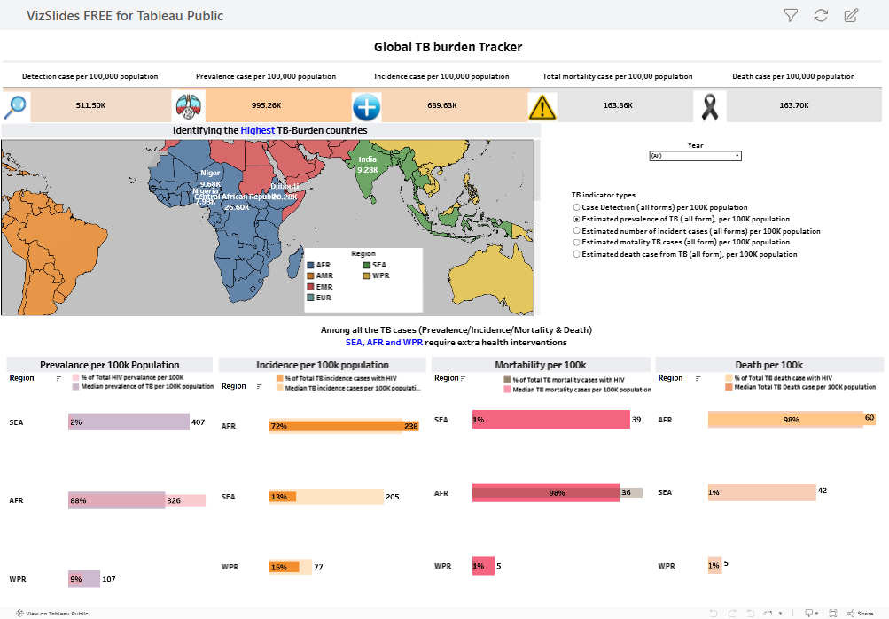
Exploration Dashboard # 1 : Global Tracker

Slide 7
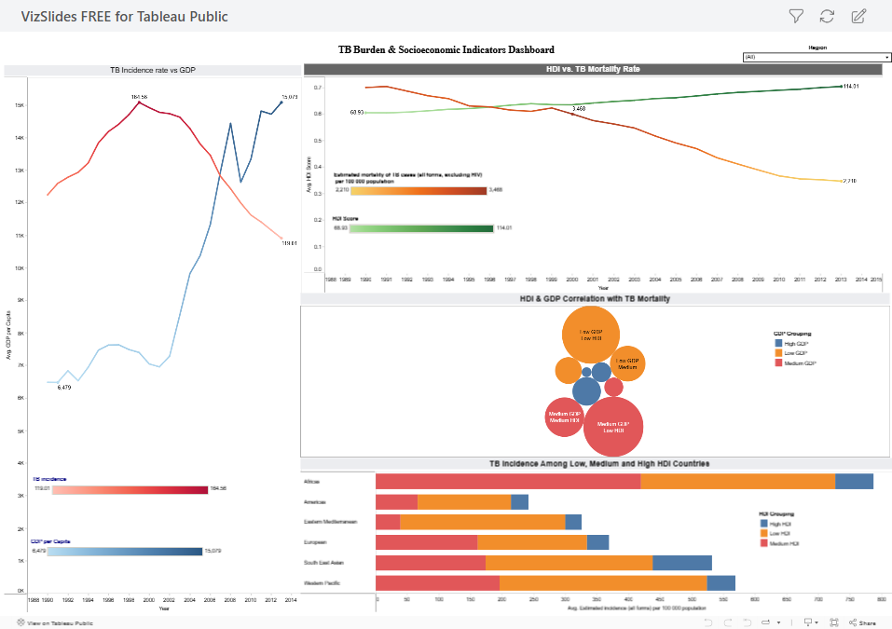
Exploration Dashboard # 2 : TB Burden & Socioeconomic

Slide 8
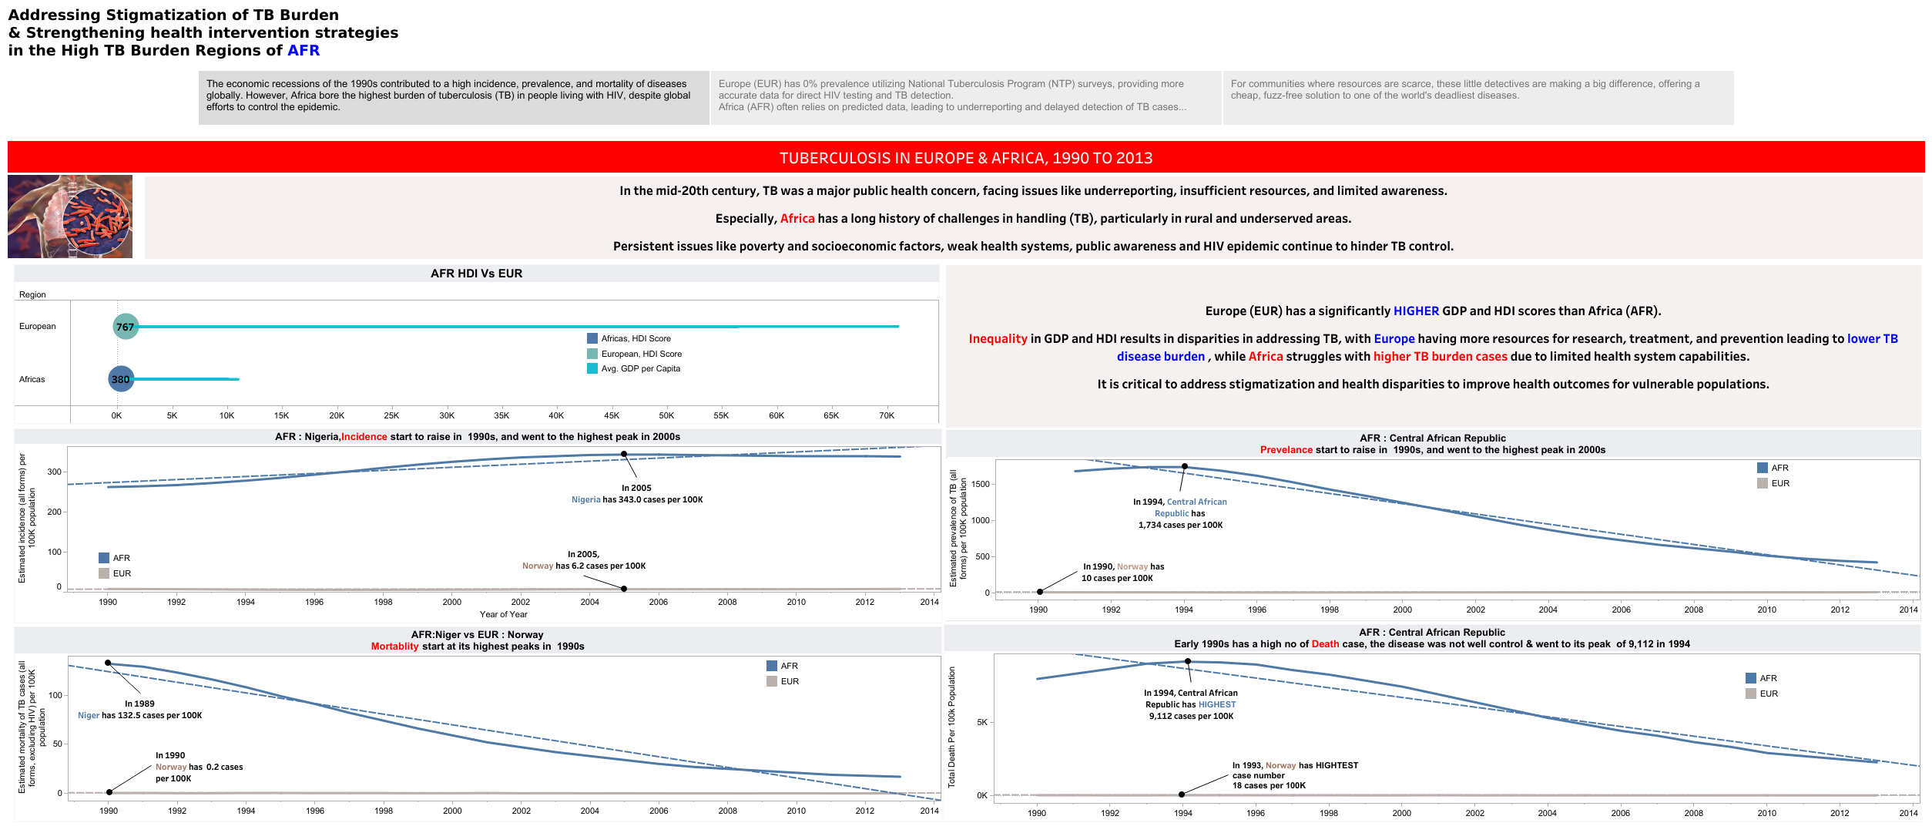
Story Board # 1

Slide 9
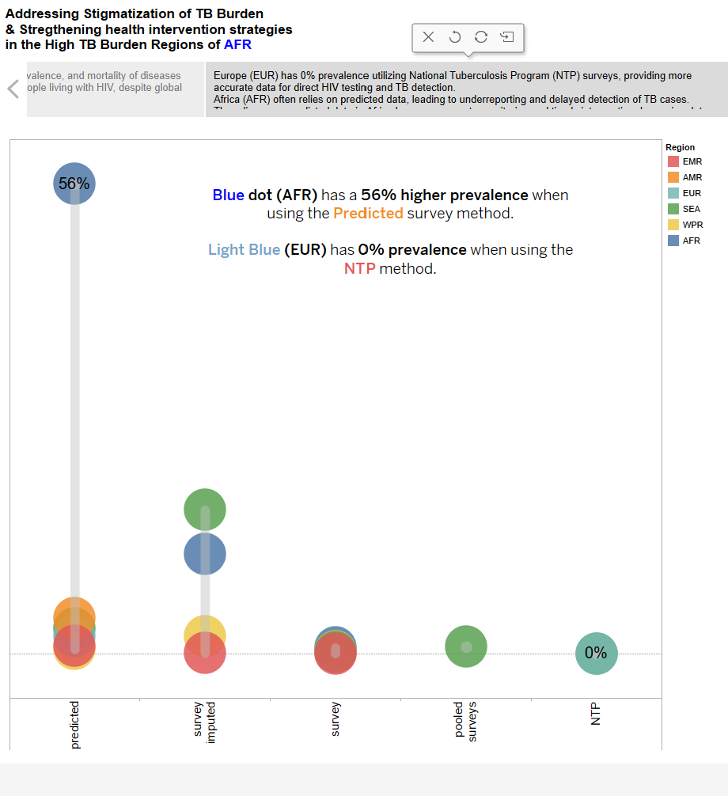
Story Board # 2

Slide 10
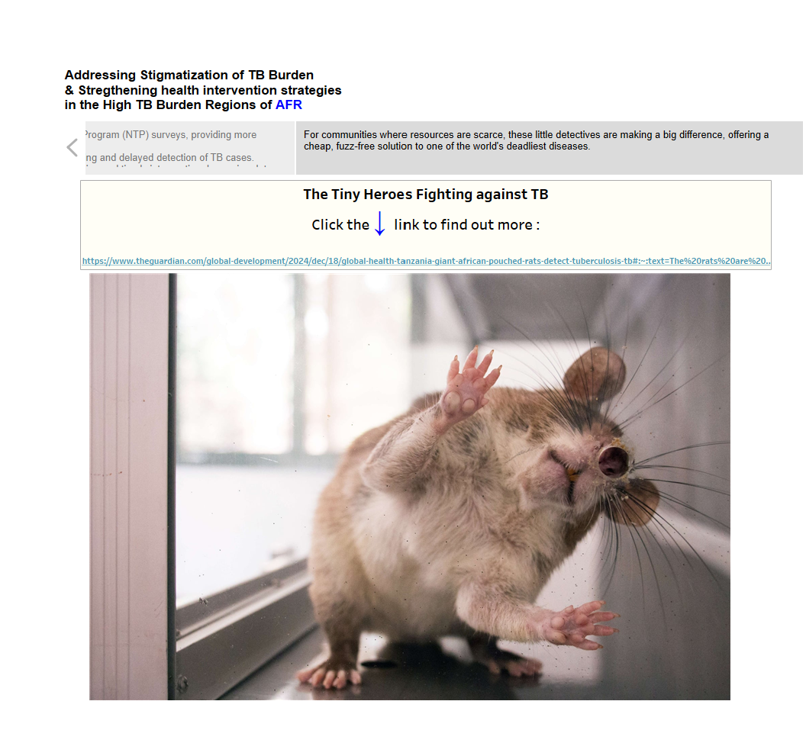
Story Board # 3

Slide 11
Actionable Insight
Expand access to quick, local testing through mobile units(CNA, 2024) and trained health workers
❤️ Support patients with nutrition, reminders, and empathetic follow-up to ensure treatment completion
📢 Run stigma-free awareness campaigns using real stories in local languages
💸 Advocate for stronger funding and free, accessible TB care across all sectors
📊 Use real-time data to identify hotspots and prevent people from falling through the cracks
🤝 Foster community partnerships – TB isn’t just a health issue, it’s a social one
🔬 Invest in innovation and listen to patients to improve care and outcomes
Notes:
References:
CNA. (2024). HIV test providers work on being more accessible via frequent mobile services, express services. https://www.channelnewsasia.com/singapore/hiv-infection-testing-action-aids-anonymous-20-minutes-4371026

